Slide 1

ACCSC Webinar:
Successful Student Achievement
Christopher Lambert
Associate Executive Director

Slide 2
Webinar Agenda
The Student Achievement Standard
Guidelines for Employment Classification
Independent Verification Requirement
Foundational Thoughts
Graduation and Employment Chart

Slide 3
Welcome from the Executive Director
Michale S. McComis, Ed.D.
Executive Director

Slide 4

Foundational Thoughts

Slide 5

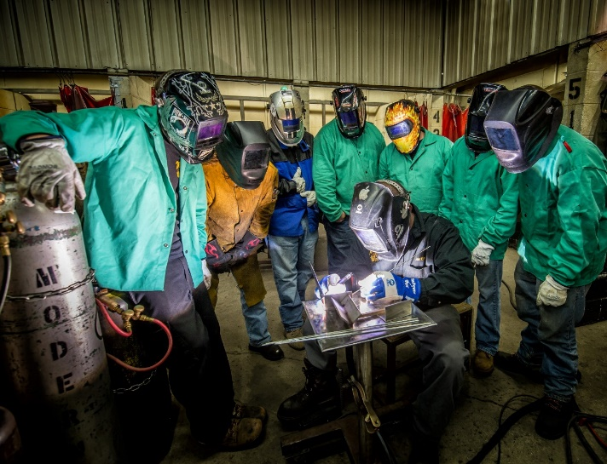

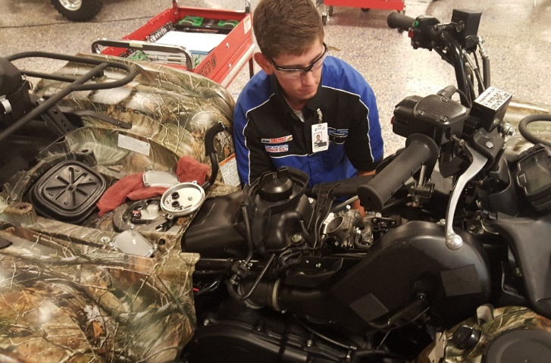
Foundational Thoughts
Meaningful things are happening every day at ACCSC- accredited institutions.

Slide 6




Foundational Thoughts
Demonstrating successful student achievement is crucial.

Slide 7
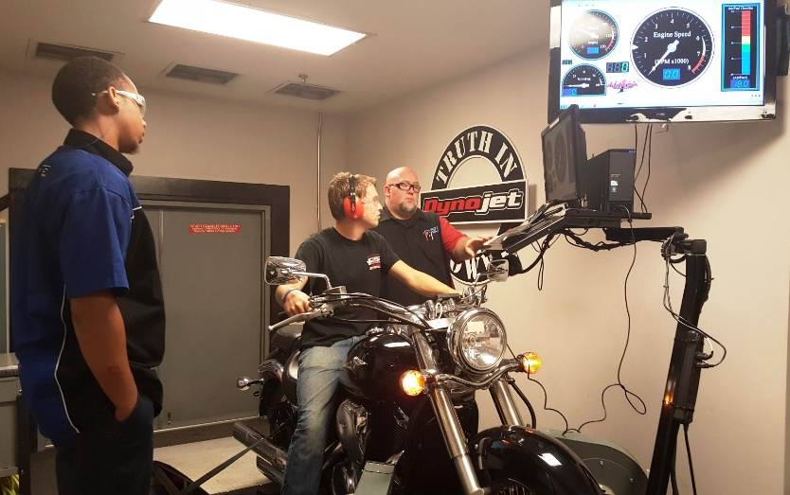


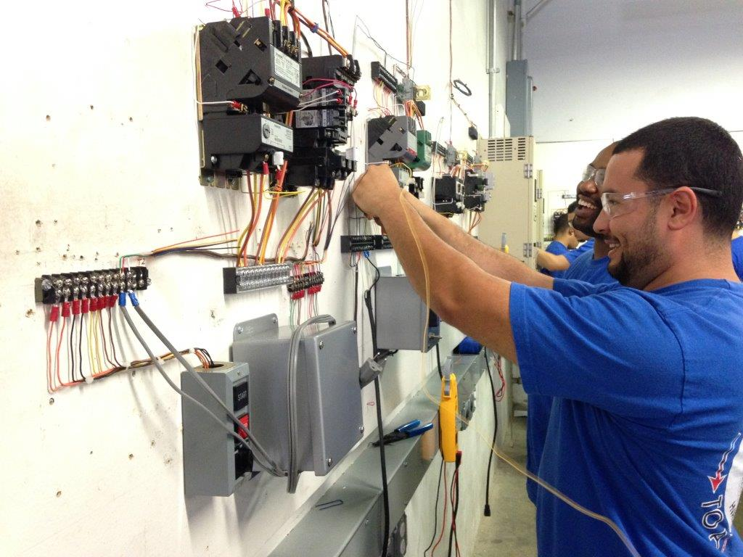
Foundational Thoughts
The enterprise of accreditation is evolving and improving.

Slide 8
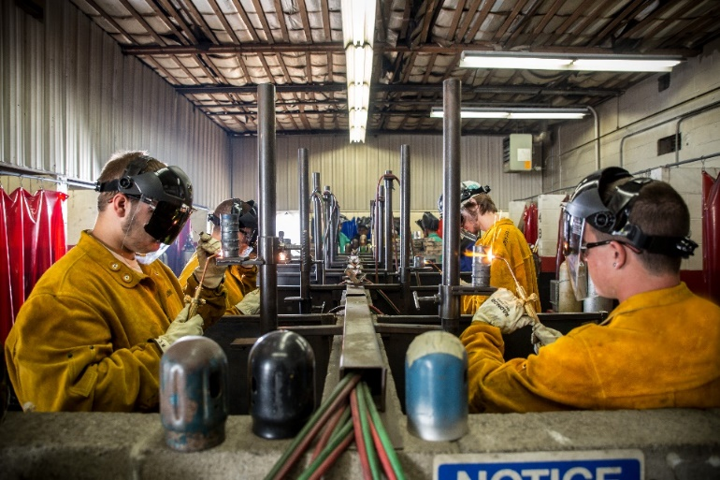


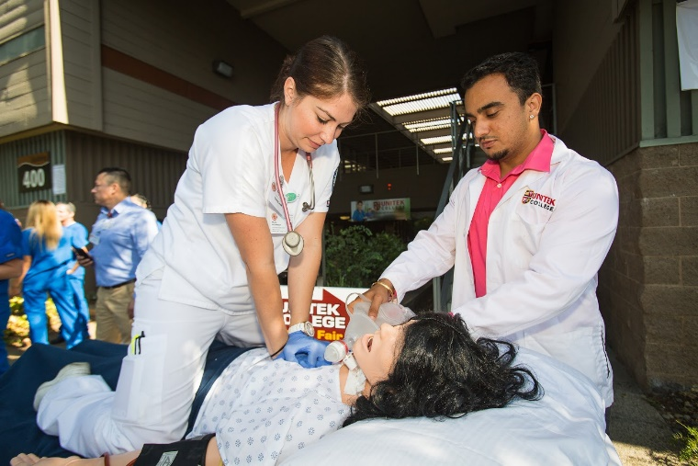
Foundational Thoughts
Changing the dialogue from skepticism to confidence.

Slide 9

The Student Achievement
Standard

Slide 10
Longitudinal Study- 2015 - 2015
11-year longitudinal study of the graduation and employment rates report from 2005 to 2015.
Goal: To discern the stability, predictability, and reliability of the rates used in establishing ACCSC’s benchmark rates.
Overall, the Commission found that the data collected and the resulting benchmarking established from that data is both stable and reliable.
These rates are semi-permanent
Rates will not be adjusted unless warranted

Slide 11
Student Achievement Standard
Established Benchmark Graduation Rates
Program Length in Months | Average Rates of Graduation Demonstrates Acceptable Student Achievement | Standard Deviation | Established Benchmark Graduation Rates*
1-3 | 92% | 8% | 84%
4-6 | 84% | 11% | 73%
7-9 | 72% | 12% | 60%
10-12 | 69% | 14% | 55%
13-15 | 64% | 14% | 50%
16-18 | 62% | 15% | 47%
19-23 | 61% | 18% | 43%
24+ | 53% | 13% | 40%

Slide 12
Student Achievement Standard
Distribution of Graduation Rates
The analysis of these data continue to show that a significant relationship exists between program length and student program completion

Slide 13
Student Achievement Standard
Established Benchmark Employment Rate
Program Length in Months | Average Rate of Employment Demonstrates Acceptable Student Achievement | Standard Deviation | Established Benchmark Employment Rate*
All Programs | 78% | 8% | 70%

Slide 14
Student Achievement Standard
Distribution of Employment Rates
Benchmark
Average
Above Average
Below Benchmark

Slide 15
Certification and Licensure
All Programs | Licensure/Certification Pass Rate Benchmark
All Programs | 70%

Slide 16
274 Total Team Findings in 66 Team Summary Reports
Considered at the May 2016 Commission Meeting
Avg. – Slightly More than 4 Team Findings Per TSR

Slide 17
191 Total Team Findings in 70 Team Summary Reports
Considered at the February 2016 Commission Meeting
Avg. – Slightly Less than 3 Team Findings Per TSR

Slide 18

Program Viability / Assessment

Slide 19
2015 Substantive Changes: Program Diversity / Adaptability

Slide 20
Program Viability and Assessment
Are graduation and employment rates getting better?
Getting worse?
Are there any mitigating factors impacting the school’s ability to demonstrate successful student achievement?
What changes has the school made with respect to the program curriculum or career service initiatives?
What do the members of the school’s Program Advisory Committee say about employment opportunities? equipment? curriculum?

Slide 21
Best Practices: Program Trends
Retention Data
Student/Graduate Satisfaction Data
Licensure Pass Rate Data
Graduate Employment Data
Employer Satisfaction Data
  What does the data say?

Slide 22
Best Practices: Program Viability
Program Viability
Definitive Action

Slide 23

Q & A
Questions
Answers
Success

Slide 24
Guidelines for Employment Classification

Slide 25
Cohort Reporting
Justification
The school must be able to justify the classification of each graduate as employed in a training related field and maintain verifiable employment records using the following guidelines. .
The school should have and adhere to policies or protocols in regard to these guidelines (reasonable time period, sustainability, relatedness, etc.).
P & P

Slide 26
The employment classification is appropriate and reasonable based on the educational objectives of the program.
The employment is directly related to the program from which the individual graduated, aligns with a majority of the educational and training objectives of the program, and is a paid position.
The employment is for a reasonable period of time, is based on program objectives, and can be considered sustainable (e.g., not a single day of employment).
P & P: Guidelines for
Employment Classification

Slide 27
Regular Employment
Documentation verifying employment and that employment is related to program of study
Aligns with a majority of the educational and training objectives
Diligent Efforts w/o Success
Regular Employment

Slide 28
Self-Employed
Self-Employment
Written Documentation (Statement) from Graduate
Attestations: Aligned with Employment Goals; Vocational; Related to Training; Making Training Related Income; Licensed
Graduate Name, Contact Info.

Slide 29
Career Advancement
Students that are already employed at time of graduation
Written Doc Maintain Employment
Career Advancement
Written Doc Eligible for Advancement

Slide 30
Q & A
Questions
Answers
Success

Slide 31

Independent Verification

Slide 32
Best Practices Webinar: Independent Third-Party Verification
The PDF version of the Webinar Slides will link directly to the resources provided.
A live recording of the 90-minute webinar is available here.
  Online at ACCSC.org under Events/Webinars
The slides from the webinar presentation are available here.
  Best Practices and Lessons Learned
The Independent Third-Party Employment Verification FAQ is available for download by clicking here.

Slide 33
Accreditation Requirements
Reliable
Documentation
Justification

Slide 34
Independent Third-Party Verification: Random Sampling
How Often?
Every Year (by ACCSC)
10% of ACCSC-Accredited Schools
How Many?

Slide 35
Independent Third-Party Verification: Accreditation Process
How Often?
Once Every Renewal Cycle (1-6 Years)
How Many?
50% Sample of all Programs

Slide 36
Independent Third-Party Verification of Employment Results
Either Verbally or In Writing
From Employer or Graduate
Results to On-Site Evaluation Team / ACCSC
Independent from the School

Slide 37
Aggregate Institutional Results Across ALL Programs
The school must provide the following chart with aggregate institutional results across all programs:
Independent Third Party Initial Employment Verification Reported Institutional Rates
Annual Report Year |  |  | Name of Company
Total number of students sampled |  | Total number of available students to sample* |  |  | Sample size percentage
Verified as Correct | Verified but Different |  |  | Unable to Verify |  | Verified as Not Correct
* Students classified as Graduates - Employed in Field across all programs for Annual Report year
Placements Verified by a Different Independent Third-Party*
Company Name | Number of Graduates Verified
* Graduates that were unable to be verified by the school’s chosen vendor but were verified by a different third-party company like “The Work Number.”

Slide 38
Verification Categories

Slide 39
The school must provide the following as part of this SER:
Verified but Different
Verified as Not Correct
Verified as Correct
Unable to Verify
The total number of students in the sample; and
The number of students in each of the categories below and the percentage in each category listed.

Slide 40
Verified as Correct
Exact Match
Start Date within 45 days of verified start date
Obvious Match
Confirmed Match
Different Title but Responsibilities Substantively the Same
Same Employer
as listed in school record

Slide 41
Verified as Correct: Automotive Technology
A completed employment record for a graduate from the Automotive Technology program indicates the graduate as being employed in field as a Mechanic.
Exact Match
Mechanic
Obvious Match
Auto-Mechanic
Confirmed Match
Technician II
Confirmed by Employer or Graduate as substantively similar
Job Responsibilities

Slide 42
Verified but Different
Verified but Different
Start Date is MORE THAN 45 Days Different
Not an Obvious Match or Confirmed Match
Substantively Different Job Title

Slide 43
Unable to Verify
Unable to obtain verification of the school’s employment record
From either the Employer
Work Number
Unable to Verify
Or the Graduate

Slide 44
Verified as Not Correct
Different Employer
Grad denies working in position
Position is unpaid / intern
Other Discrepancies
Graduate Record Not Found in Employer’s Records

Slide 45

Independent Verification Results
  2014 / 2015 – Accreditation Cycle

Slide 46
Independent Verification: 2 Year Totals
226 Schools with Results
28 Different Independent Third Parties
16,933 records
95% (215 of 226) schools met the required 50% sample.
  17% (39 of 226) submitted 100% samples.

Slide 47
Independent Verification: 2 Year Totals
8%
21%
69%
226 Schools with Results
16,933 records

Slide 48
Independent Verification: 2014/15 Accreditation Cycle
 | Verified as Correct | Not Verified | Verified but Different | Verified as Not Correct
January 2014 | 59% (1586 of 2668) | 30% (808) | 8% (205) | 3% (69)
March 2014 | 78% (995 of 1270) | 13% (163) | 7% (91) | 2% (21)
July 2014 | 77% (2344 of 3026) | 16% (493) | 5% (143) | 2% (46)
September 2014 | 57% (1359 of 2365) | 28% (655) | 13% (312) | 2% (39)
January 2015 | 69% (2243 of 3229) | 17% (553) | 11% (356) | 3% (86)
March 2015 | 68% (1044 of 1546) | 16% (248) | 14% (215) | 2% (39)
May 2015 | 79% (475 of 603) | 14% (87) | 4% (22) | 3% (19)
July 2015 | 71% (1585 of 2226) | 15% (323) | 11% (254) | 3% (64)
Overall | 69% (11,631 of 16,933) | 20% (3,330) | 9% (1598) | 2% (383)

Slide 49
Independent Verification: Commission Activity
Total Number Schools Subject to Employment Verification:
507
Total Number of Employment Verification Actions:
184
Information Request: 20%
Accept Report: 34%
Warning / Probation: < 2%
Additional Compliance Findings

Slide 50
Q & A
Questions
Answers
Success

Slide 51

The Graduation and Employment Chart
A Line by Line Analysis

Slide 52
How to Determine Reporting Periods
How to Successfully Complete the Graduation and Employment Chart
The Graduation and Employment Chart

Slide 53
The G/E Chart
A Graduation and Employment Chart is required for each program offered.
A separate G/E chart will be required for F/T and P/T program.
Reporting periods will differ among individual programs with different program lengths given the impact of SAP.

Slide 54
How to Determine Reporting Periods
Two Welding Programs One F/T (8-month) One P/T (12-month)
  Two Separate Graduation and Employment Charts
    Based on Length of Program
Assumption: 8-month program
Report Date: July 2016 (07/2016)
Length of Program 8 months
Multiply Length by 1.5 times 4 months
Add Three Months for Placement 15 months
Start of Reporting Period:
07/16 minus 12 months = 03/2015
End of Reporting Period:
03/15 minus 12 months = 04/2014
Assumption: 12-month program
Report Date: July 2016 (07/2016)
Length of Program 12 months
Multiply Length by 1.5 times 6 months
Add Three Months for Placement 21 months
End of Reporting Period:
07/16 minus 12 months = 09/2014
Start of Reporting Period:
09/2014 minus 12 months = 10/2013

Slide 55
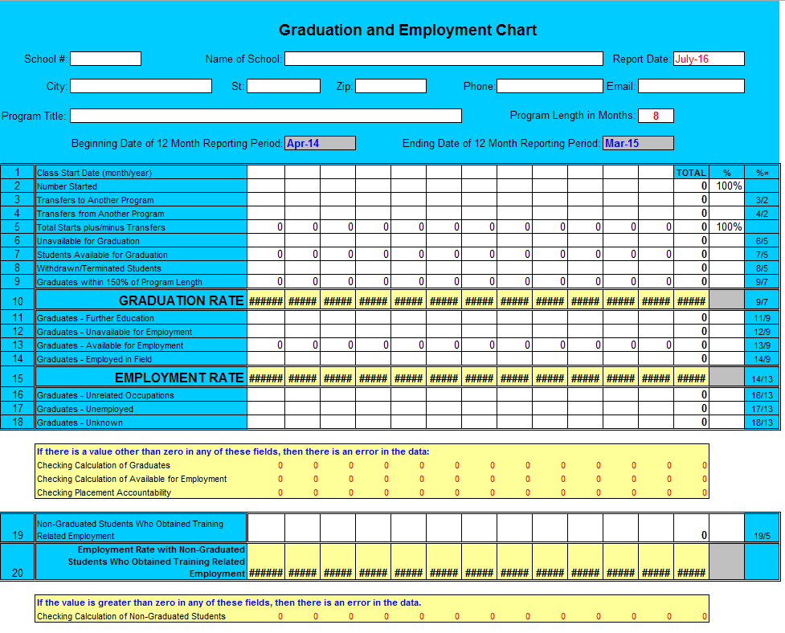
The Graduation and Employment Chart

Slide 56
About the Graduation and Employment Chart
You will note there are a series of Tabs included on the Graduation and Employment Chart:
G&E Chart
Instructions
Glossary
Other Features
The Graduation and Employment Chart automatically calculates the Report Period
  Based on length of program and report date
Automatically calculates summary categories based on data entered
Includes a self-checking mechanism to ensure there are no errors in data.

Slide 57
Cohort Reporting
What is a Cohort?
A “cohort” is defined as a group of students that start a particular program together at a campus.
Students are tracked based on Start Date
How do I group students?
There are 12 columns on the G&E Chart, thus programs with rolling starts should be combined by month.
  The Graduation and Employment Chart provides a mechanism to track individual students by cohort within the prescribed report period (dictated by program length).

Slide 58






















Welding: 8 months – Certificate – 22 Starts in Report Period

Slide 59

Tips and Practical Advice
Consistency of Policies and Procedures as it Relates to Students is Critical.
Through the accreditation process, ACCSC will evaluate the consistent application of a school’s policies and procedures
File Review
Admissions
Enrollment Agreement
S.A.P.
Student Services
Transcripts
Refunds
Every. Student. Enrolled.

Slide 60










Welding: 8 months – Certificate – 22 Students in Two Starts During Report Period
(4/14 & 10/14)
April 2014 – 10 Students Start
October 2014 – 12 Students Start

Slide 61
Track 10 students that started the 8-month Welding Program (certificate) together in April 2014.

Slide 62
Track 10 students that started the 8-Month Welding program in April 2014
Welding: 8 months – Certificate – 10 Starts in Cohort
1
2
3
5
6
4
7
8
9
10

Slide 63
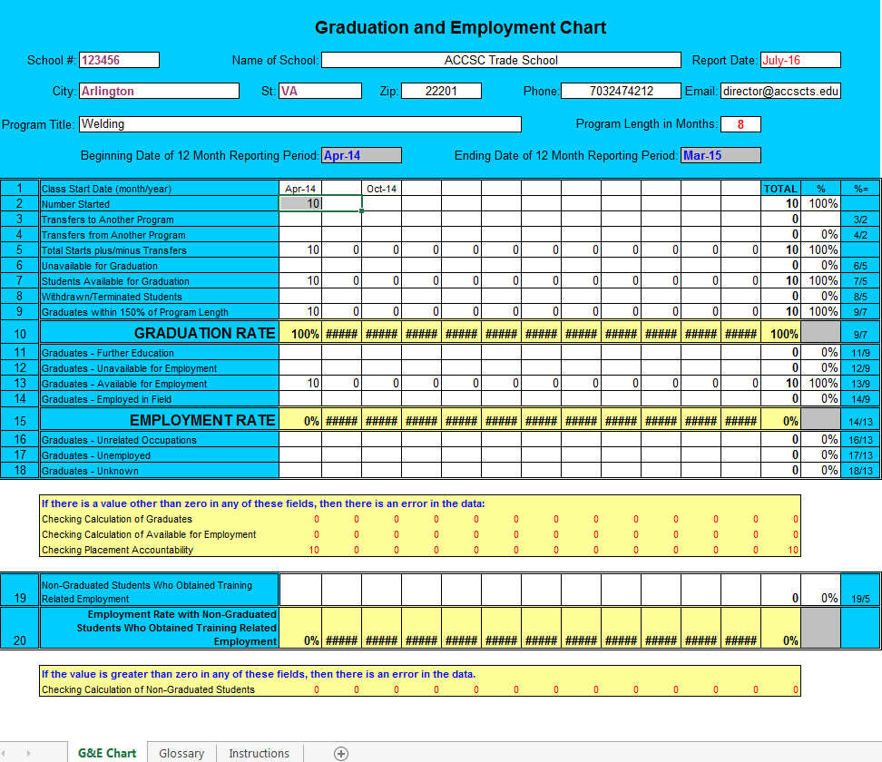
The Graduation and Employment Chart
10 students start in the 8-Month Welding Program in April 2014

Slide 64


Cohort Tracking –Practical Exercise
Line 3: Transfer TO Another Program (at the same campus)
Student 5
Transfers from the Welding 8-Month FT program to the Welding 12-Month program offered at the school
Line 3
Transfer to Another Program = 1

Slide 65
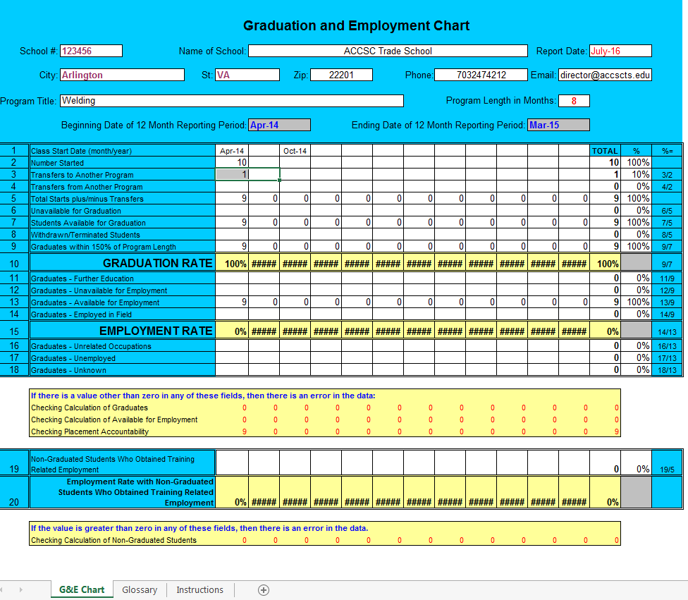

The Graduation and Employment Chart
Line 3
Transfer to Another Program = 1
Student #5
Transfers from the Welding 8-Month FT program to the Welding 12-Month program offered at the school

Slide 66

Line 4: Transfer FROM Another Program (at the same campus)
1 Student transfers from the 8-month Welding Program to the 12-month Welding program offered at the school.
This student will be captured on Line 4 of the G/E Chart for the 12-month Welding Program offered at the same campus.
1
2
3
5
6
4
Line 4
Student #11: Enrolled in 12-month Welding Program
Transfer from Another Program (into 8-month)
7
8
9
11
10

Slide 67

The Graduation and Employment Chart
Line 4
Student #11: Enrolled in 12-month Welding Program
Transfer from Another Program at the same campus into 8-month Welding program.
11

Slide 68

Line #5: Total Starts +/- Transfers (auto-calculated)
  Line #2: 10 Starts
  Line #3: 1 Transfer TO another program (from 8-month to 12-month)
  Line #4: 1 Transfer FROM another program (from 12-month to 8-month)
Line #5: 10 Total Starts

Slide 69
Line 6: Unavailable for Graduation
This category removes from the graduation rate calculation students who fall into one of the following four classifications:
Death
Incarceration
Onset of a medical condition that prevents continued enrollment
Active Military Deployment
Requires Supporting Documentation

Slide 70



Line 6: Unavailable for Graduation
9
Student #9:
Active military service deployment
School maintains record to support categorizing this students as Unavailable for Graduation

Slide 71

Line #7: Students Available for Graduation (Auto-Calculation)
1
2
3
Line #7: Students Available for Graduation
Line #2: 10 Starts
Line #3: 1 Transfer TO another program
Line #4: 1 Transfer FROM another program
Line #5: 10 Total Starts plus/minus transfers
Line #6: 1 Student Unavailable for Graduation (active military)
Line #7: 9 Students Available for Graduation
5
6
4
7
8
9
11
10

Slide 72
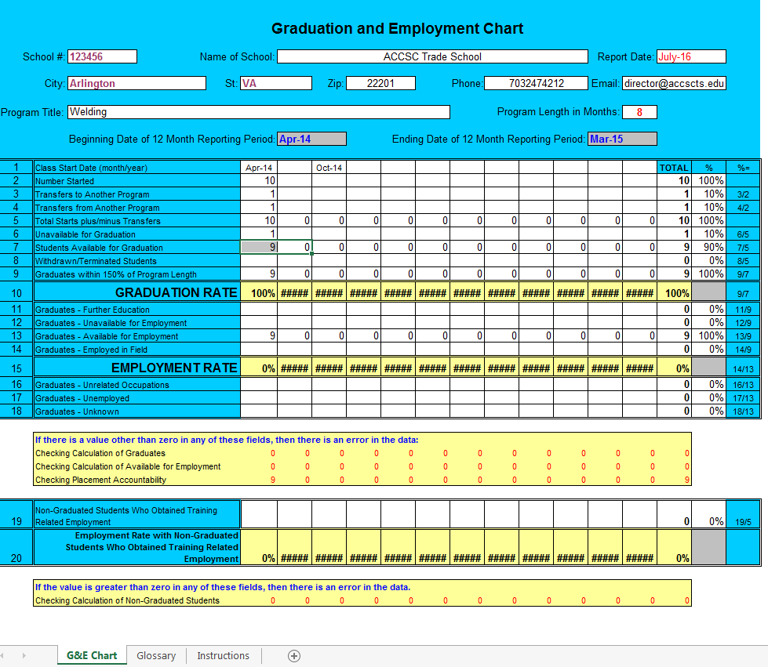
Line #7: Students Available for Graduation (Auto-Calculation)
Line #7: Students Available for Graduation (auto-calculated)
Line #2: 10 Starts
Line #3: 1 Transfer TO another program
Line #4: 1 Transfer FROM another program
Line #5: 10 Total Starts plus/minus transfers
Line #6: 1 Student Unavailable for Graduation (active military)
Line #7: 9 Students Available for Graduation

Slide 73


Line #8: Withdrawn / Terminated Students
The number of students who withdrew or were terminated, within 150% of the program length, from each program.
This number does not include the student classified as "Unavailable for Graduation" (Line 6).
Student #3 – Withdrew
Student #10 – Terminated SAP
Line #8: 2 Withdrawn / Terminated Students
3
10

Slide 74
Line #9 Graduates with 150%
Line #10: Graduation Rate (for this cohort)
7 Graduates out of 9 Possible from Cohort
78% Graduation Rate (for this cohort)
Line #9, Line #10, and Line #13 Auto-Calculated
Line #13: 7 Graduates are Available for Employment
Self-Check: 7 Graduates Need to be Tracked for “Placement Accountability”

Slide 75
Line #2: 10 Starts
Line #3: 1 Transfer TO another program
Line #4: 1 Transfer FROM another program
Line #5: 10 Total Starts plus/minus transfers
Line #6: 1 Student Unavailable for Graduation (active military)
Line #7: 9 Students Available for Graduation
Line #8: 2 Withdrawn (1) / Terminated (1)
Line #9: 7 Graduates within 150% of Program Length (transcript available)
78% Graduation Rate
1
2
3
5
6
4
7
8
9
11
10

Slide 76
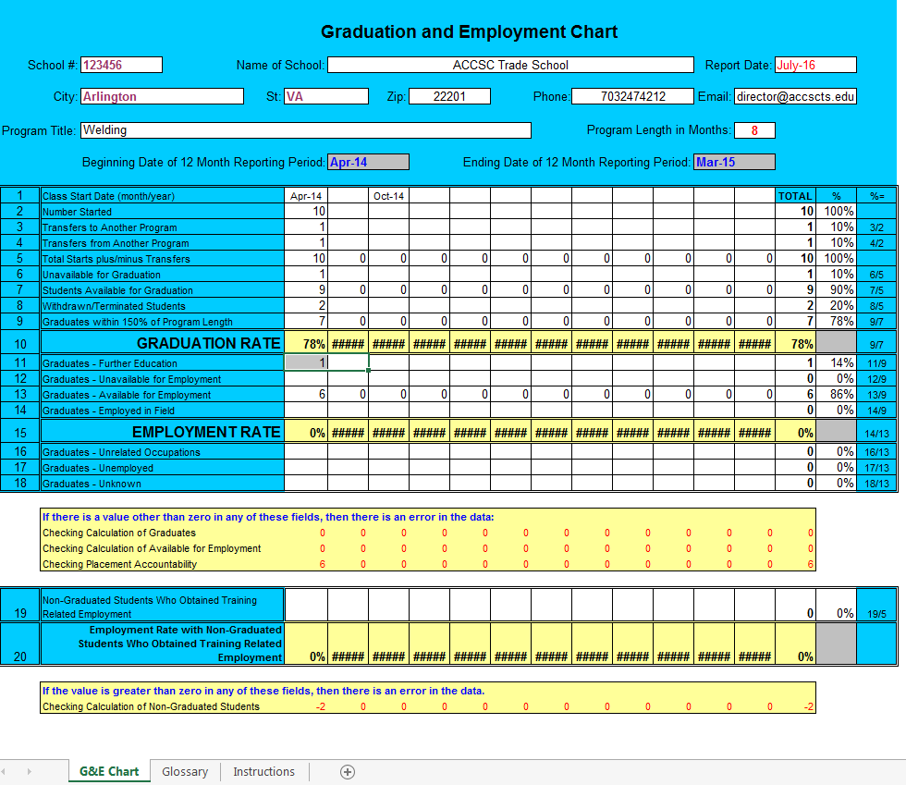


Line #11: Graduates – Further Education
The number of graduates that continue on with education in an accredited institution of higher education (postsecondary) on at least a half-time basis.
11

Slide 77
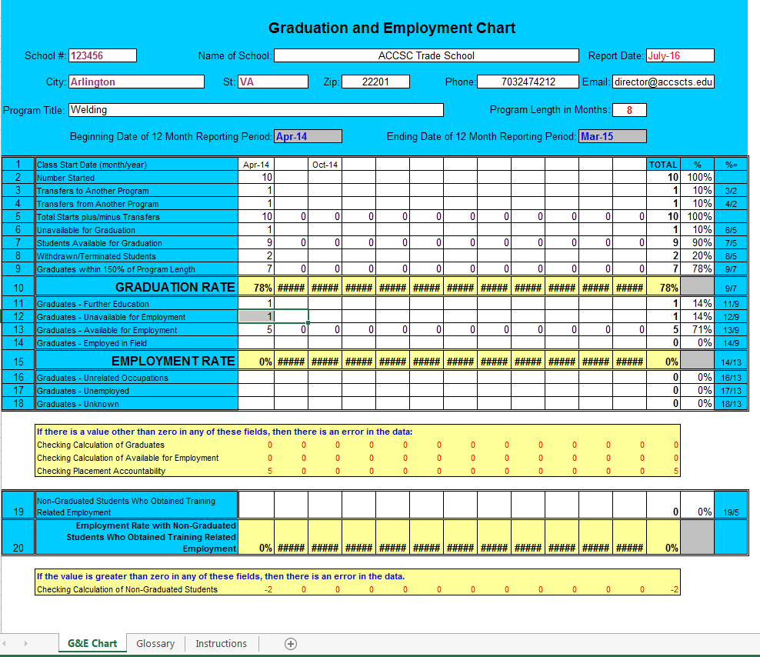

Line #12: Graduates – Unavailable for Employment
This category removes from the placement rate calculation graduates who fall into one of the following categories:
    death,
    incarceration,
    active military service deployment,
    the onset of a medical condition that prevents employment,
    or international students who have returned to their country of origin.
6

Slide 78
Line #13: Graduates Available for Placement
Line #9: 7 Graduates within 150% of Program Length
Line #11: 1 Graduate Further Education (Student #11)
Line #12: 1 Graduate Unavailable for Employment (Student #6)
Line #13: 5 Graduates Available for Employment (auto-calculated)
1
2
4
7
8

Slide 79



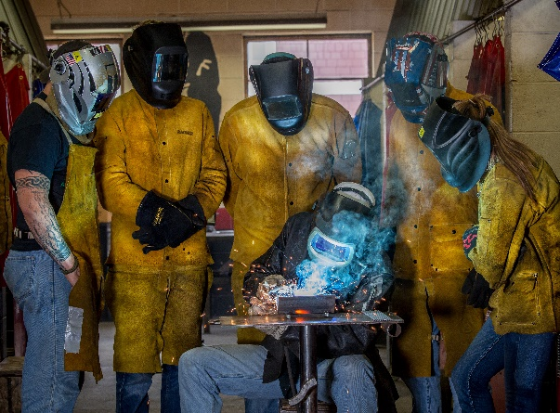


Line #14: Graduates – Employed in Field
For the April 2014 Cohort Start: 80% (Four of Five) Graduates got a Job as a Welder.
7
2
8
1

Slide 80

Line #9: 7 Graduates within 150% of Program Length
Line #11: 1 Graduate Further Education (Student #11)
Line #12: 1 Graduate Unavailable for Employment (Student #6)
Line #13: 5 Graduates Available for Employment (Students #1, #2, #4, #7, & #8)
Line #14: 4 Graduates Employed in Field (Students #1, #2, #7 & #8)
Line #15: Placement Rate: 80%
But there is an error on the chart….

Slide 81
An Error? What do you mean there is an error?!?!
I followed the instructions.
My records are well organized
Where did I go wrong?
This is not my fault.
I wish the chart could tell me….
Who is missing?

Slide 82



Who is missing?
Line #16: Graduates – Unrelated Occupations
4
=

Slide 83
Line 19: Non-Graduated Students Who Obtained Training Related
The number of withdrawn/terminated students from Line 8 who obtain employment in a field related to the program in which the student was enrolled and based upon the training provided by the school.
3
10

Slide 84
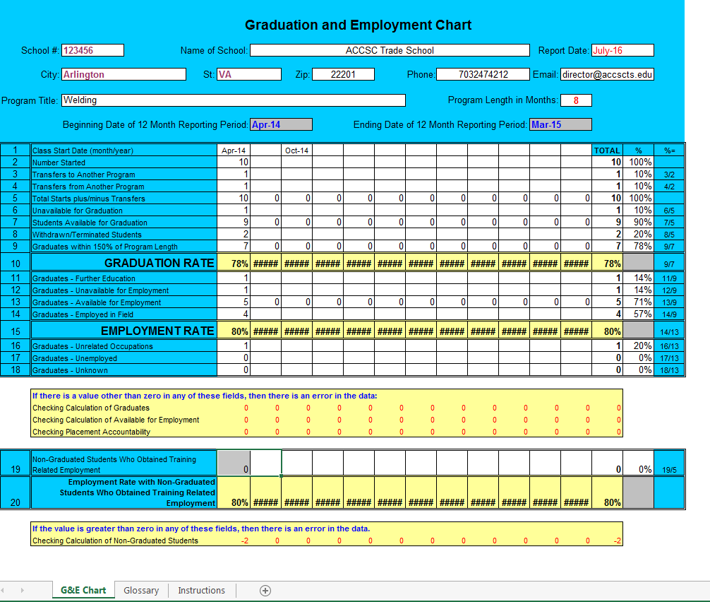
Line 19/20: Non-Graduated Students Who Obtained Training Related
The number of withdrawn/terminated students from Line 8 who obtain employment in a field related to the program in which the student was enrolled and based upon the training provided by the school.
  Neither individual is working in field (which requires certifications).
3
10

Slide 85
Based on this cohort, which is one of two monthly cohorts (starts) during the reporting period (April 2014-March 2015), the reported rates of student achievement for the 8-month Welding program are:
78% Graduation Rate
80% Employment Rate

Slide 86

Welding: 8 months – Certificate – 22 Starts in Report Period

Slide 87
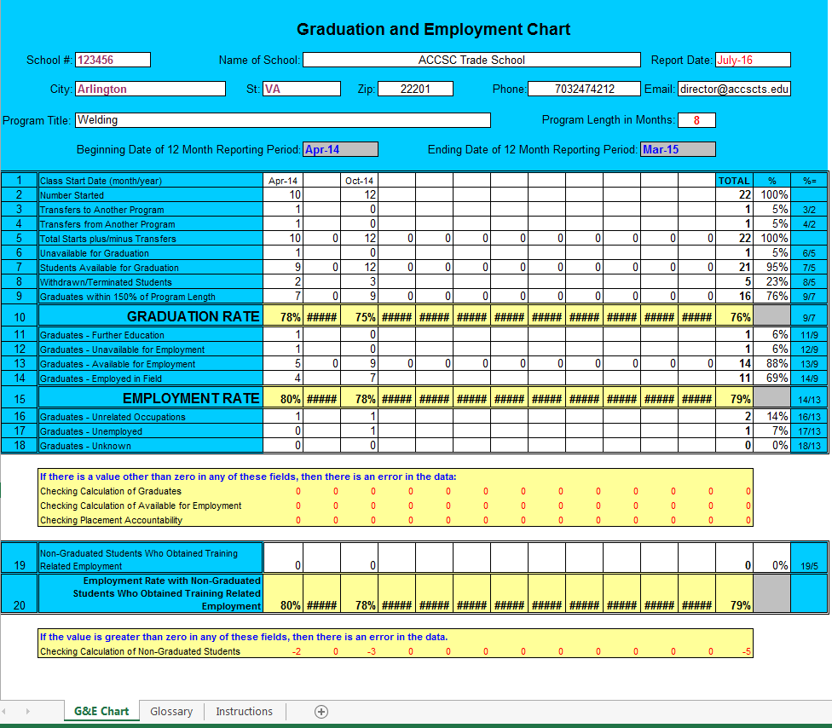
Welding: 8 months – Certificate – 22 Students in Two Starts During Report Period
(4/14 & 10/14)
10 starts in April
12 starts in October
76% Graduation Rate
79% Employment Rate

Slide 88
More than Just a Number….
According to the 2015 ACCSC Annual Report, 6,965 students were captured in 95 Graduation and Employment Charts for Welding programs.
The Reported Graduation Rate for ALL Welding Programs: 70%
The Reported Employment Rate for ALL Welding Programs: 75%
But what it means…..
Due to the programs and services offered by ACCSC-accredited institutions, and because of the hard work, dedication, and effort put forth by students:
4,859 successful Graduates
3,656 Newly Trained Welders working in the field.
Skepticism to Confidence.
Workforce Development

Slide 89
Verifiable Employment Record
Date of Initial Employment
Place of Employment
Employer Address and Phone Number / Contact Person & Supervisor
Graduate Name and Contact Information;
Descriptive Job Title and Responsibilities

Slide 90
Helpful Hint: Start Dates
Organize all supporting documentation by program, by start date
Organize graduate transcripts by program, by start date
Organize verifiable records of initial employment by program, by start date

Slide 91
Best Practices: Employment Verification Form
Employment Verification Form
Graduate Name |  | Program Title (Credential) |  |  |  | Start Date / Grad Date
John Q. Student |  | Welding (Certificate) |  |  |  | April 1, 2015 / December 31, 2015
Job Title |  |  | Employer |  | Employer Contact Information
Welder |  |  | Rooney Welding 4321 Terry Bradshaw Street Homer City, Pennsylvania |  | Mel Blount, Owner 412.444.5656 melblount@rooney.com
Descriptive Job Responsibilities | Graduate Contact Information |  |  | Date of Hire / Salary Info |  | Date Verification Received by School
Welding (tack, arc, tig, mig) , Pipe-Fitting, Maintenance Welding, Fabrication | 1234 Donnie Shell Ave. Indiana, Pennsylvania 412-555.1212 johnqstudent.@gmail.com |  |  | January 1, 2016 $22 per hr; 40 hr week. |  | January 5, 2016 Rocky Bleier Rocky Bleier Director, Career Service
Notes:

Slide 92
Best Practices: Verification Form Challenges
Employment Verification Form
Graduate Name |  | Program Title (Credential) |  |  |  | Start Date / Grad Date
Jane P. Student |  | Welding (Certificate) |  |  |  | December 1, 2015
Job Title |  |  | Employer |  | Employer Contact Information
Assistant |  |  | ABC Industries 58 Jack Lambert Way Pittsburgh, Pennsylvania |  | ABC Industries 412-555-9696
Descriptive Job Responsibilities | Graduate Contact Information |  |  | Date of Hire / Salary Info |  | Date Verified by School
Works in Shop | 88 Lynn Swan Blvd. Erie, PA N/A janepstudent@abctechinstitute.com |  |  | November 15, 2015 / Intern |  | (Blank)
Notes:
Start Date?
Job Training Related?
No Point of Contact / No Email
Lack of description
No Phone #, School Issued Email
Start Date Precedes Grad Date / Intern = Paid Position?
Not internally verified.

Slide 93
ACCSC Webinar:
Successful Student Achievement
Christopher Lambert
Associate Executive Director

